Slide 1
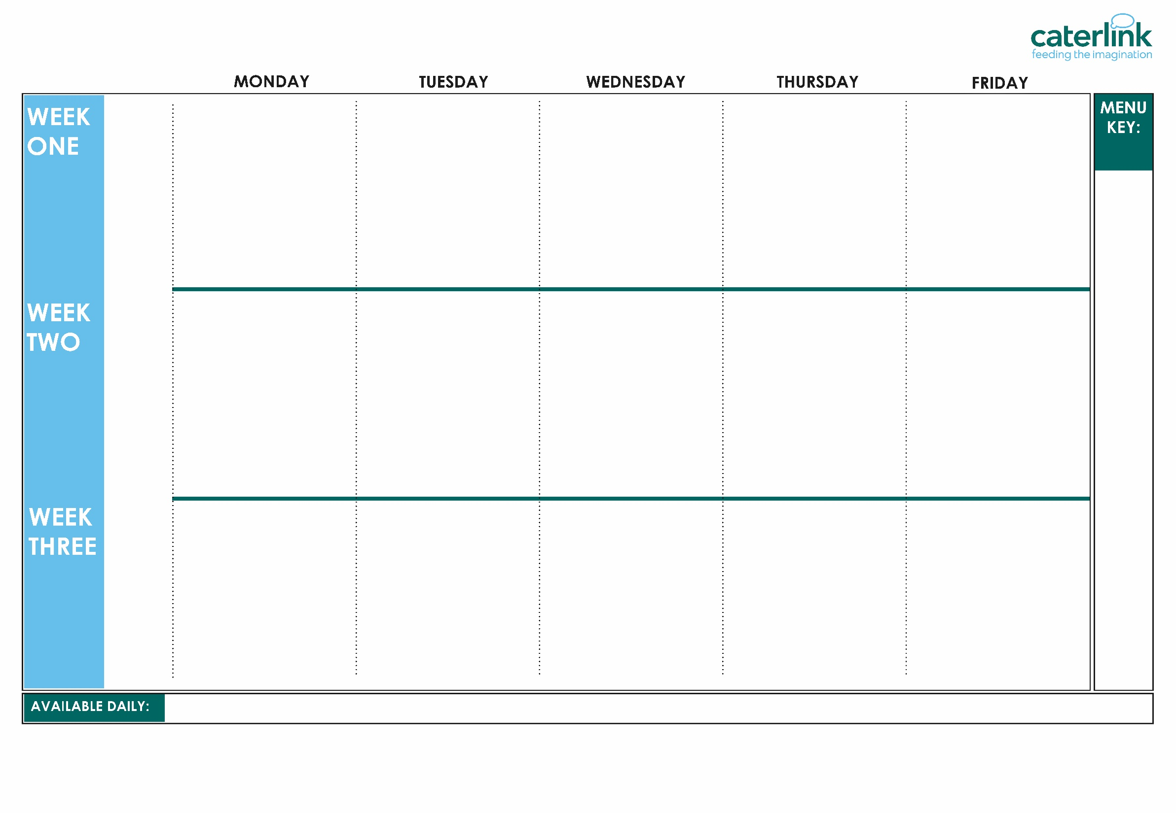





WINTER MENU 2026
Wholemeal French Bread Cheese & Tomato Pizza with Wedges | Beef Lasagne with Garlic Bread | Roast Chicken, Stuffing, Roast Potatoes & Gravy | Chicken Korma with Rice | Fishfingers with Chips & Tomato Sauce
Tomato Pasta | Vegan Cottage Pie | Roasted Quorn, Stuffing, Roast Potatoes, & Gravy | NEW BBQ Sausage Pasta with Garlic Bread | Cheese & Bean Pasty with Chips & Tomato Sauce
Vegetables of the Day | Vegetables of the Day | Vegetables of the Day | Vegetables of the Day | Vegetables of the Day
Cheese and Crackers | NEW Apple Crumb Cake with Custard | Fruit Medley | Jelly with Mandarins | Syrup Sponge with Custard
Option
One
Option
Two
Sides
Dessert
Whole
grain
Wholemeal French Bread Cheese & Tomato Pizza with Wedges | Spaghetti Bolognaise | Roast of the Day, Roast Potatoes & Gravy | Meatballs in Tomato Sauce with Rice | Fish Fingers with Chips & Tomato Sauce
Macaroni Cheese | Vegan Spaghetti Bolognaise | Vegan Sausages, Roast Potatoes & Gravy | Mild Mexican Chilli with Rice | Cheese Whirl with Chips and Tomato Sauce
Vegetables of the Day | Vegetables of the Day | Vegetables of the Day | Vegetables of the Day | Vegetables of the Day
NEW Gingerbread Cookie | Chocolate and Beetroot Brownie with Chocolate Sauce | Fruit Salad | Sticky Toffee Apple Crumble with Custard | Vanilla Shortbread
Option
One
Option
Two
Sides
Dessert
Plant
based
Added plant protein
Chef’s Special
Jacket Potatoes with a choice of fillings, Salad Bar, Freshly Baked Bread, Fresh Fruit, Yoghurt
If you would like to know about particular allergens in foods, please ask a member of the catering team for information. If your child has a school lunch and has a food allergy or intolerance you will be asked to complete a form to ensure we have the necessary information to cater for your child. We use a large variety of ingredients in the preparation of our meals and due to the nature of our kitchens it is not possible to completely remove the risk of allergen cross contact.

Slide 2
WINTER MENU 2026
V115 Wholemeal French Bread Cheese & Tomato Pizza with SD6 Wedges | B52 Beef Lasagne with SD50 Garlic Bread | C4 C5 Roast Chicken, SD40 Stuffing, SD82 Roast Potatoes and SD118 Gravy | C86 Chicken Korma with SD84 Rice | F6 Fishfingers with SD5 Chips & SD14 Tomato Sauce
V302 Tomato Pasta | V241 Vegan Cottage Pie | V204 Roasted Quorn, SD40 Stuffing, SD82 Roast Potatoes and SD118 Gravy | NEW V270 BBQ Sausage Pasta with SD50 Garlic Bread | V191 Cheese & Bean Pasty with SD5 Chips & SD14 Tomato Sauce
Vegetables of the Day | Vegetables of the Day | Vegetables of the Day | Vegetables of the Day | Vegetables of the Day
D56 Cheese and Crackers | NEW D268 Apple Crumb Cake with D2 Custard | D224 Fruit Medley | D235 Jelly with Mandarins | D197 Syrup Sponge with D2 Custard
Option
One
Option
Two
Sides
Dessert
Whole
grain
V115 Wholemeal French Bread Cheese & Tomato Pizza with SD6 Wedges | SD8 Spaghetti B48 Bolognaise | C4 C5 P10 P5 T1 B4 Roast of the Day Roast Potatoes and SD118 Gravy | B57 Meatballs in V225 Tomato Sauce with SD84 Rice | F6 Fishfingers with SD5 Chips & SD14 Tomato Sauce
V318 Macaroni Cheese | V233 Vegan SD8 Spaghetti Bolognaise | V238 Vegan Sausages, SD82 Roast Potatoes and SD118 Gravy | V309 Mild Mexican Chilli with SD84 Rice | V27 Cheese Whirl with SD5 Chips & SD14 Tomato Sauce
Vegetables of the Day | Vegetables of the Day | Vegetables of the Day | Vegetables of the Day | Vegetables of the Day
NEW D267 Gingerbread Cookie | D169 Chocolate and Beetroot Brownie with D3 Chocolate Sauce | D223 Fruit Salad | D243 Sticky Toffee Apple Crumble with D2 Custard | D57 Vanilla Shortbread
Option
One
Option
Two
Sides
Dessert
Plant
based
Added plant protein
Chef’s Special
Jacket Potatoes with a choice of fillings, Salad Bar, Freshly Baked Bread, Fresh Fruit, Yoghurt
If you would like to know about particular allergens in foods, please ask a member of the catering team for information. If your child has a school lunch and has a food allergy or intolerance you will be asked to complete a form to ensure we have the necessary information to cater for your child. We use a large variety of ingredients in the preparation of our meals and due to the nature of our kitchens it is not possible to completely remove the risk of allergen cross contact.

